Slide 1
Chapter 2: Operating System Structures

Slide 2
Outline
Outline
Operating System Services
User Operating System Interface
System Calls
System Programs
Operating System Structure
Objectives
To describe the services an operating system provides to users, processes, and other systems
To discuss the various ways of structuring an operating system

Slide 3
Operating System Services
For user
User interface
Program execution
I/O operations
File-system manipulation
Process communication
Error detection and handling
For System: efficiency and sharing
Resource allocation
Accounting
Protection and security

Slide 4
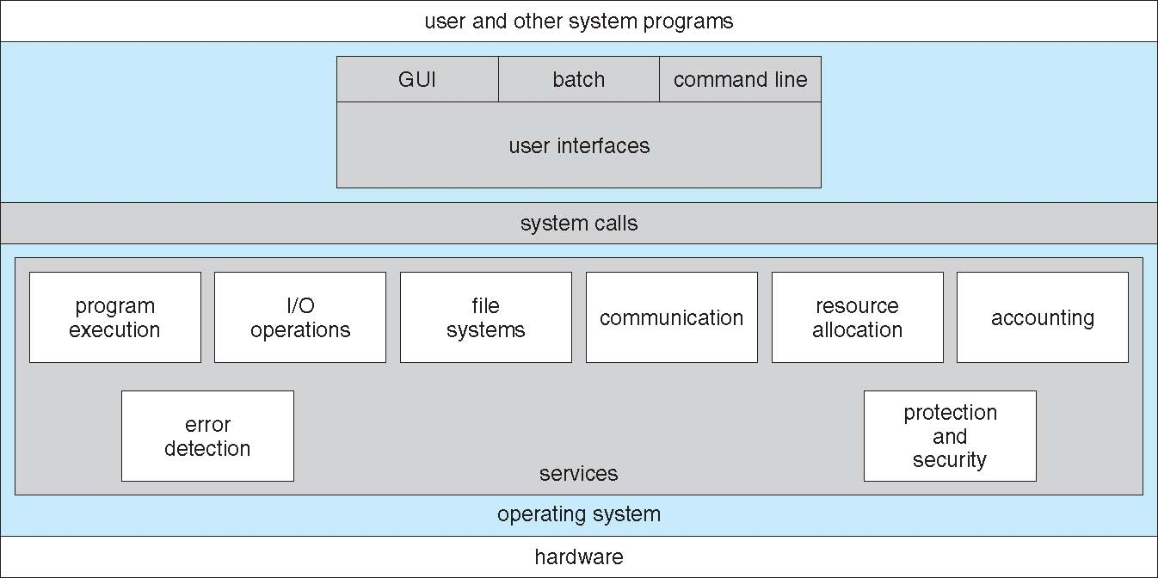
OS Services

Slide 5
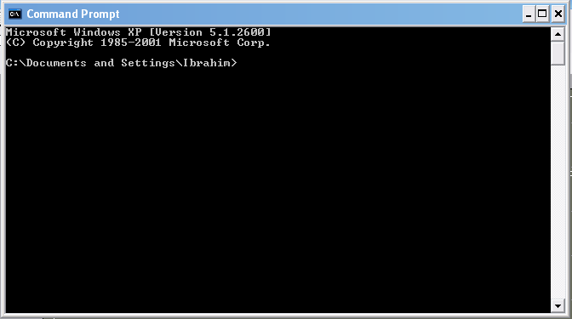
[User - Operating System] Interface - CLI
CLI: Command Line Interface (CLI) or command interpreter (shell)
fetches a command from user and executes it
in kernel or a system program,
many flavors
Command may be built-in,
Command may be another program
GUI: User-friendly desktop interface
Icons represent files, programs, actions, etc.
Many operating systems now include both CLI and GUI interfaces
Linux: command shells available (CLI); KDE as GUI

Slide 6
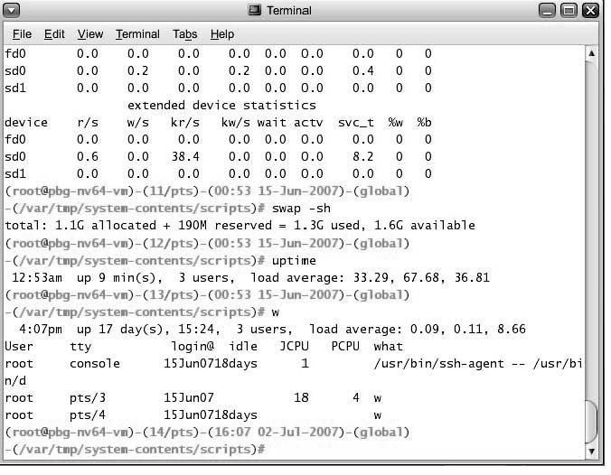
Bourne Shell Command Interpreter

Slide 7
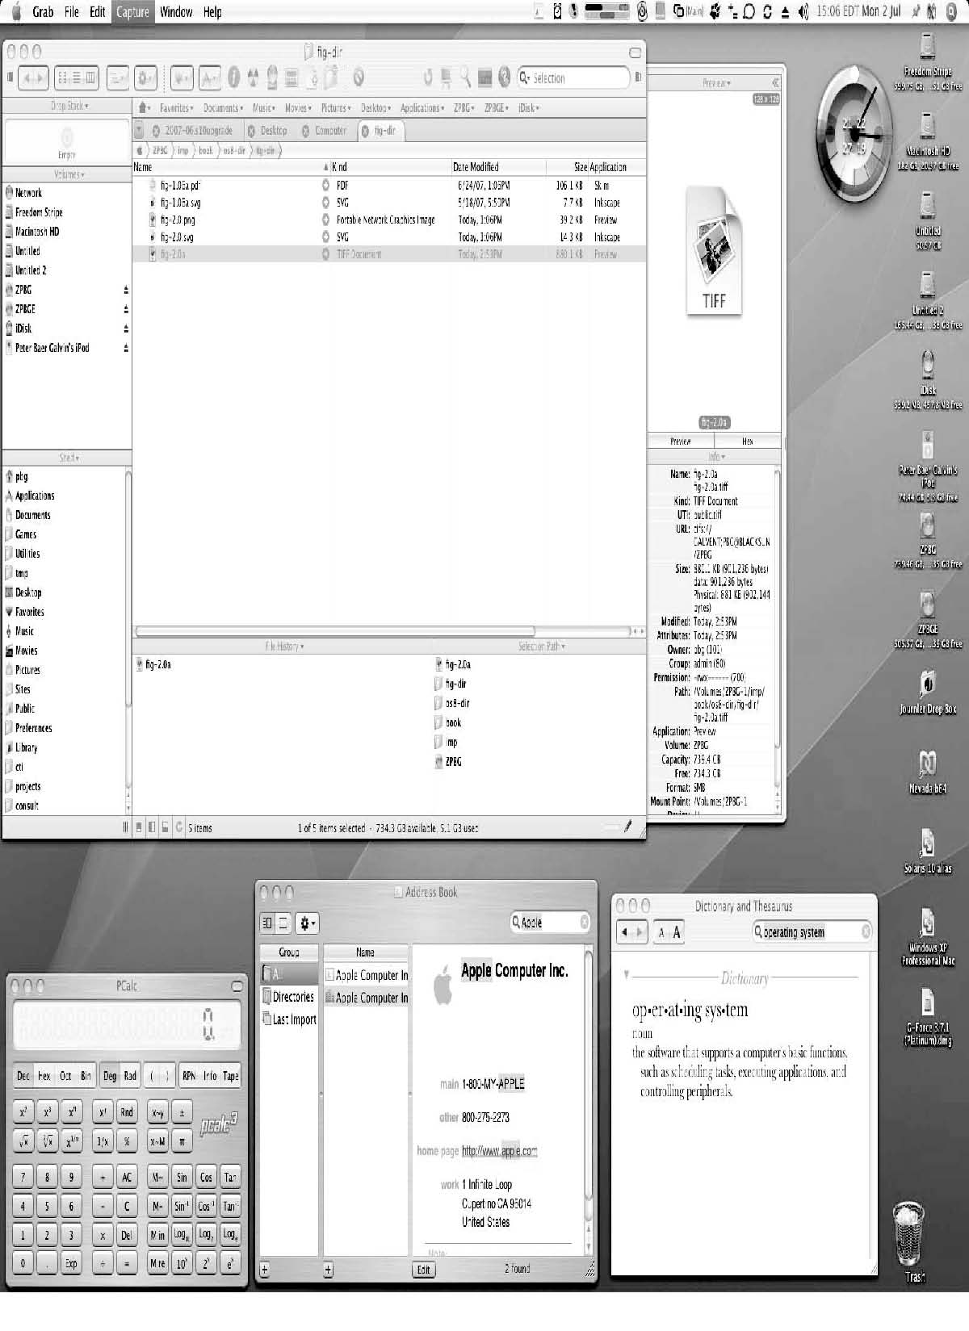
The MacOS X GUI

Slide 8
System Calls
Programming interface to the services provided by the OS
i.e., interface provided to applications (commands and programs)
Typically written in a high-level language (C or C++)
Are called by a running program to get service from kernel
“making a system call’ or “calling a system call”
Even a simple program may make a lot of calls per second.

Slide 9
System Calls
Application
(a process, a running program)
Application
System Call Interface
….
System Calls
(OS functions)
Each has a name, number, set of parameters
Other kernel functions
Kernel/OS
other kernel functions can be called by system calls

Slide 10
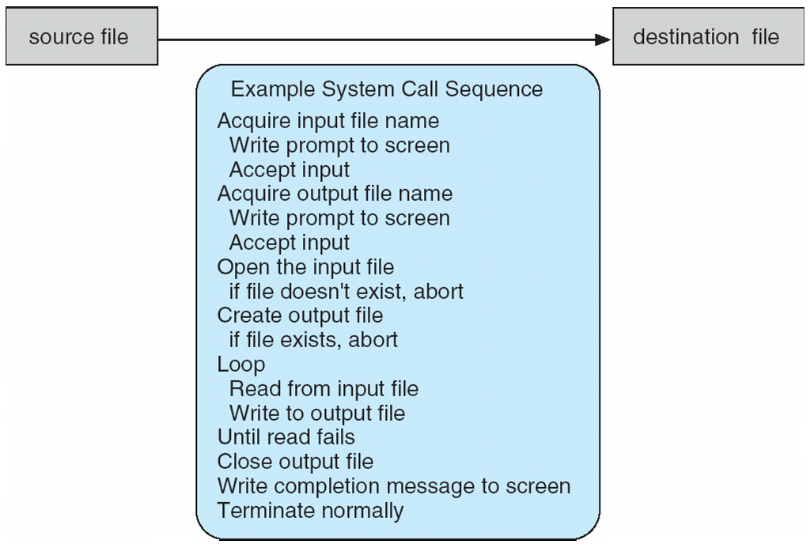
Example of System Calls
System call sequence to copy the contents of one file to another file

Slide 11
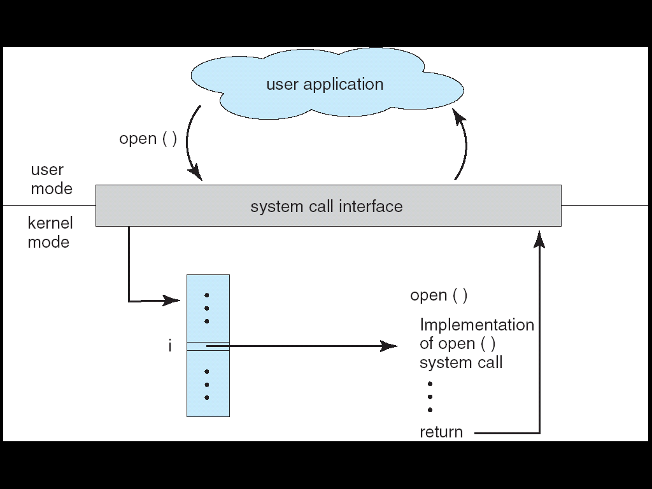
System Call Implementation and Calling
Typically,
a number associated with each system call
Number is used as index to a table: System Call Table
Table keeps addresses of system calls (system routines)
System call runs and returns
Caller does not know system call implementation
Just knows interface

Slide 12
Linux x86-64 system calls (64 bit)
0 read // read from a file
1 write // write into a file
2 open // open a file
3 close // close a file
4 stat // get file attribs
9 mmap // map a file
12 brk // extend heap segmnt
32 dup2 // dup file desc
33 pause
37 alarm // set an alarm
39 getpid // get process id
57 fork // create a new process
59 execve // run a new program
60 _exit // terminate the program
61 wait4 // wait for child
62 kill // send signal

Slide 13
Invoking a system: Linux and x86 architecture
Making a System Call
CPU
Move system call number
into eax register
Move parameters
Execute TRAP instruction
int $0x80
eax
ebx
ecx
CPU registers

Slide 14
System Call Parameter Passing
Often, more information is required than the identity (number) of the desired system call
Exact type and amount of information vary according to OS and call
Three general methods used to pass parameters to the OS
1) Simplest: pass the parameters in registers
In some cases, may be more parameters than registers
2) Parameters stored in a block, or table, in memory, and address of the block passed as a parameter in a register
3) Parameters placed, or pushed, onto the stack by the program and popped off the stack by the operating system
Last two methods do not limit the number or length of parameters being passed

Slide 15
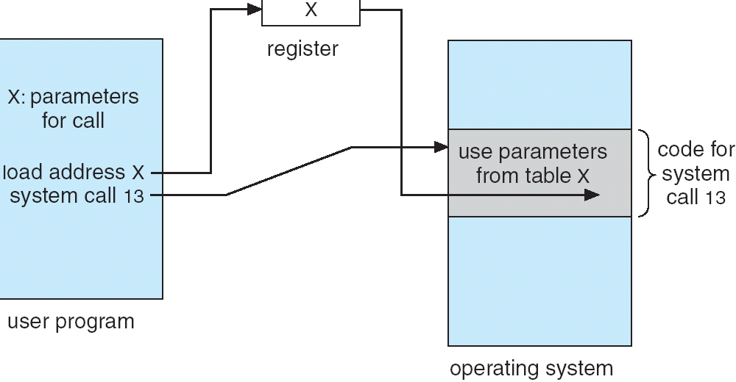
Parameter Passing via Table

Slide 16
Accessing and executing System Calls
System calls typically not accessed directly by programs
Mostly accessed by programs via a high-level Application Program Interface (API) (i.e. a library) rather than direct system call use
Three most common APIs are :
Win32 API for Windows,
POSIX API for POSIX-based systems (including virtually all versions of UNIX, Linux, and Mac OS X),
Java API for the Java virtual machine (JVM)
Program
API (std lib)
OS
Sys Calls
Rest of Kernel

Slide 17
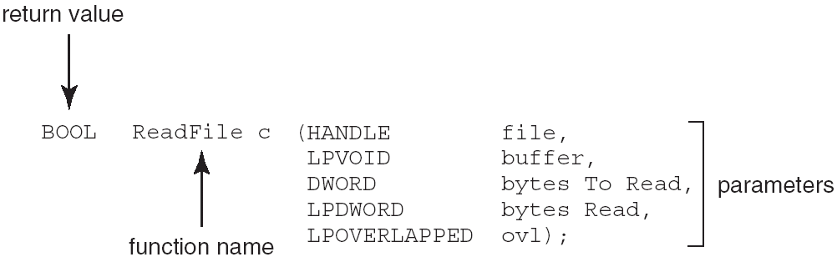
Example of Standard API - Windows
Consider the ReadFile() function in the Win32 API — a function for reading from a file
A description of the parameters passed to ReadFile()
HANDLE file—the file to be read
LPVOID buffer—a buffer where the data will be read into and written from
DWORD bytesToRead—the number of bytes to be read into the buffer
LPDWORD bytesRead—the number of bytes read during the last read
LPOVERLAPPED ovl—indicates if overlapped I/O is being used

Slide 18
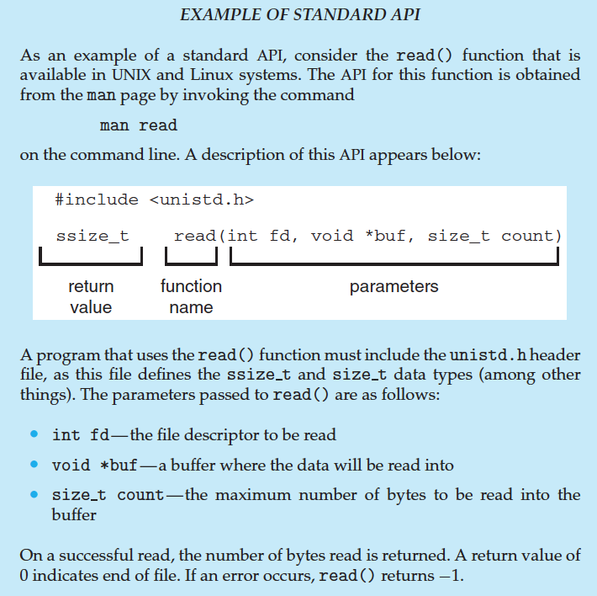
Example of Standard API - Linux

Slide 19
Why use APIs rather than system calls directly?
Your Program
…
fd =open(…);
….
Your Program Code
user level code
API
open (…) {…}
fopen(…)
{…}
Standard C library Code
System Calls
sys_open (…)
{…}
Kernel Code
kernel level code

Slide 20
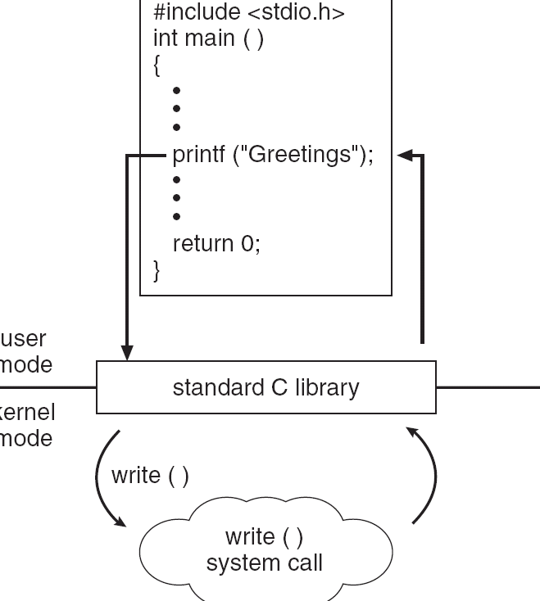
Standard C Library Example
C program invoking printf() library call, which calls write() system call

Slide 21
Types of System Calls
Process control
File management
Device management
Information maintenance
Communications
Protection

Slide 22
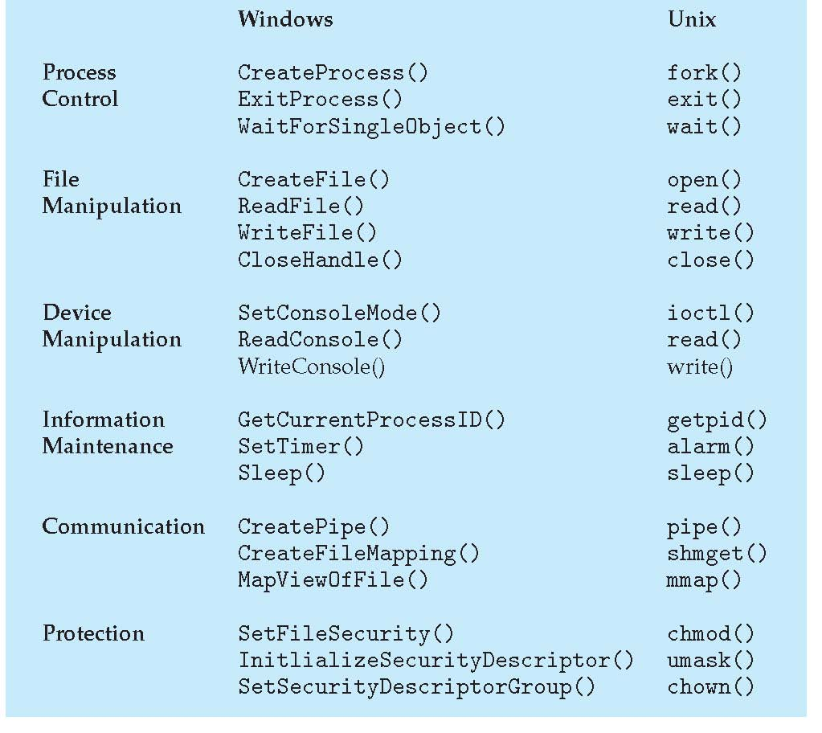
Examples of Windows and Unix System Calls

Slide 23
Hello World with direct Linux System Call
hello.c
hello.S
﻿int main()
{
write(1,
“hello, world\n”,
13);
_exit(0)
}
﻿.section .data
string:
.ascii "hello, world\n”
string_end:
.equ len, string_end - string.section
.text.globl
mainmain:
movq $1, %rax #write system call
movq $1, %rdi
movq $string, %rsi #put the string
movq $len, %rdx #put length
syscall #make the call
movq $60, %rax #exit system call
movq $0, %rdi
syscall
In 64 bit Linux
for x86_64 arch

Slide 24
Hello World with direct Linux System Call
Compile and run the assembly version as below:
$ gcc -c hello.S -o hello.o
$ gcc -no-pie hello.o -o hello
$ ./hello

Slide 25
System Programs
System programs provide a convenient environment for program development and execution. They can be divided into:
File manipulation (create, delete, copy, rename, print, list, …)
Status information (date, time, amount of available memory, disk space, who is logged on, …)
File modification (text editors, grep, …)
Programming language support (compiler, debuggers, …)
Program loading and execution (loaders, linkers)
Communications (ftp, browsers, ssh, …)
Other System Utilities/Applications may come with OS CD (games, math solvers, plotting tools, database systems, spreadsheets, word processors, …)

Slide 26
System Programs
Most users’ view of the operation system is defined by system programs, not the actual system calls
Some of them are simply user interfaces to system calls; others are considerably more complex
create file: simple system program that can just call “create” system call or something similar
compiler: complex system program

Slide 27
System Programs
Users (People)
System Programs
Other User Applications
System Calls
Kernel
From OS’s view: system+user programs are all applications

Slide 28
OS Design and Implementation

Slide 29
Design goals
User goals
System goals
Mechanisms and policies
Separate mechanisms from policies
Mechanism: how to do
Policy: what to do
Implementation
C, C++ (high level language)
Porting to different architectures

Slide 30
Structuring Operating System

Slide 31
OS Structure
Simple Structure (MSDOS)
Layered Approach
Microkernel Approach
Modules Approach

Slide 32
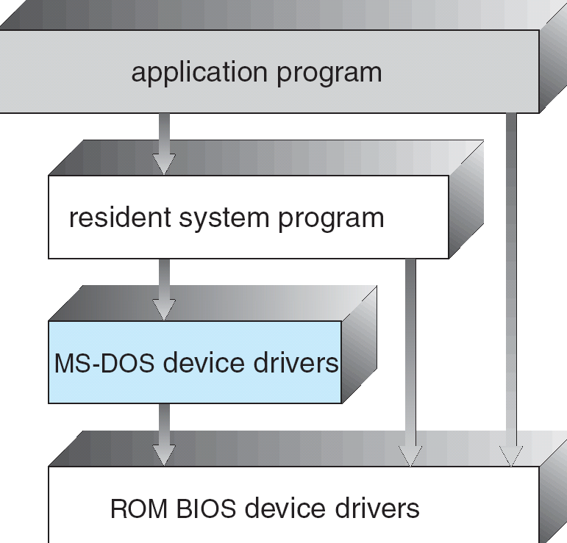
Simple Structure
MS-DOS – written to provide the most functionality in the least space
Not divided into modules
Although MS-DOS has some structure, its interfaces and levels of functionality are not well separated

Slide 33
Layered Approach
The operating system is divided into a number of layers (levels), each built on top of lower layers. The bottom layer (layer 0), is the hardware; the highest (layer N) is the user interface.
With modularity, layers are selected such that each uses functions (operations) and services of only lower-level layers
Functions of L3
overall system
Functions of L2
Functions of L1

Slide 34
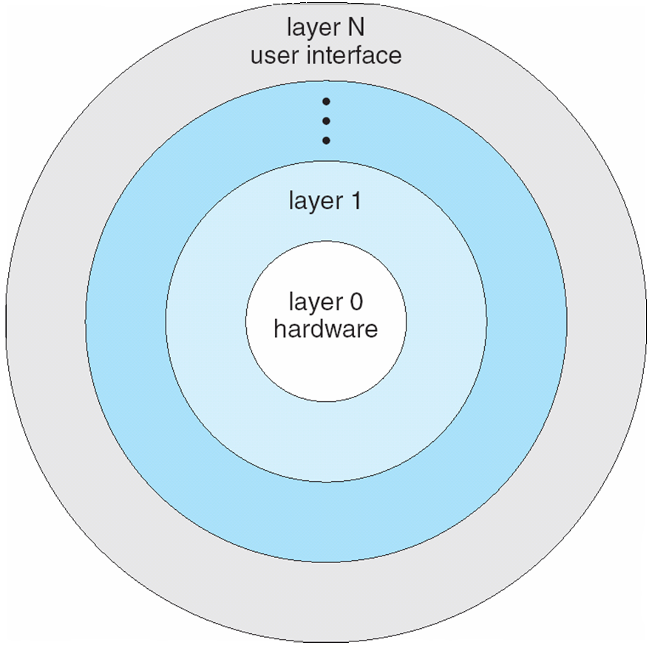
Layered Operating System

Slide 35
Unix
UNIX – limited by hardware functionality, the original UNIX operating system had limited structuring. The UNIX OS consists of two separable parts
Systems programs
The kernel
Consists of everything below the system-call interface and above the physical hardware
Provides the file system, CPU scheduling, memory management, and other operating-system functions; a large number of functions for one level

Slide 36
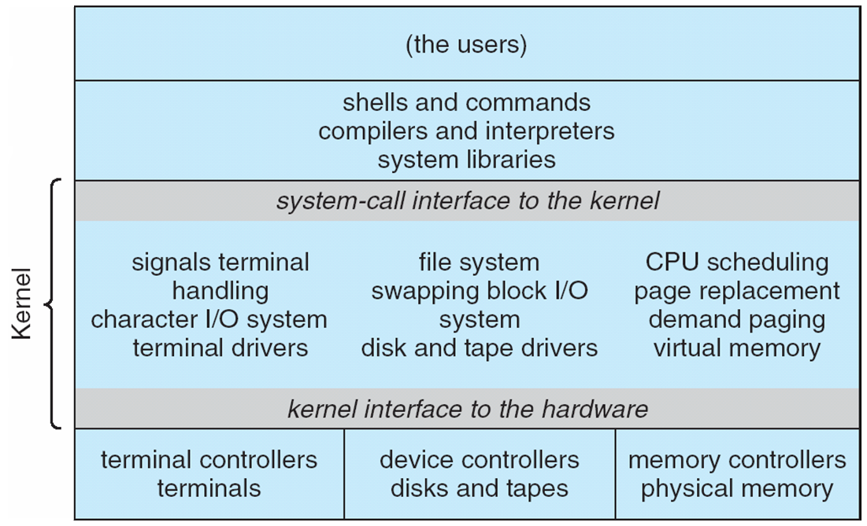
Traditional UNIX System Structure
system programs
and libraries

Slide 37
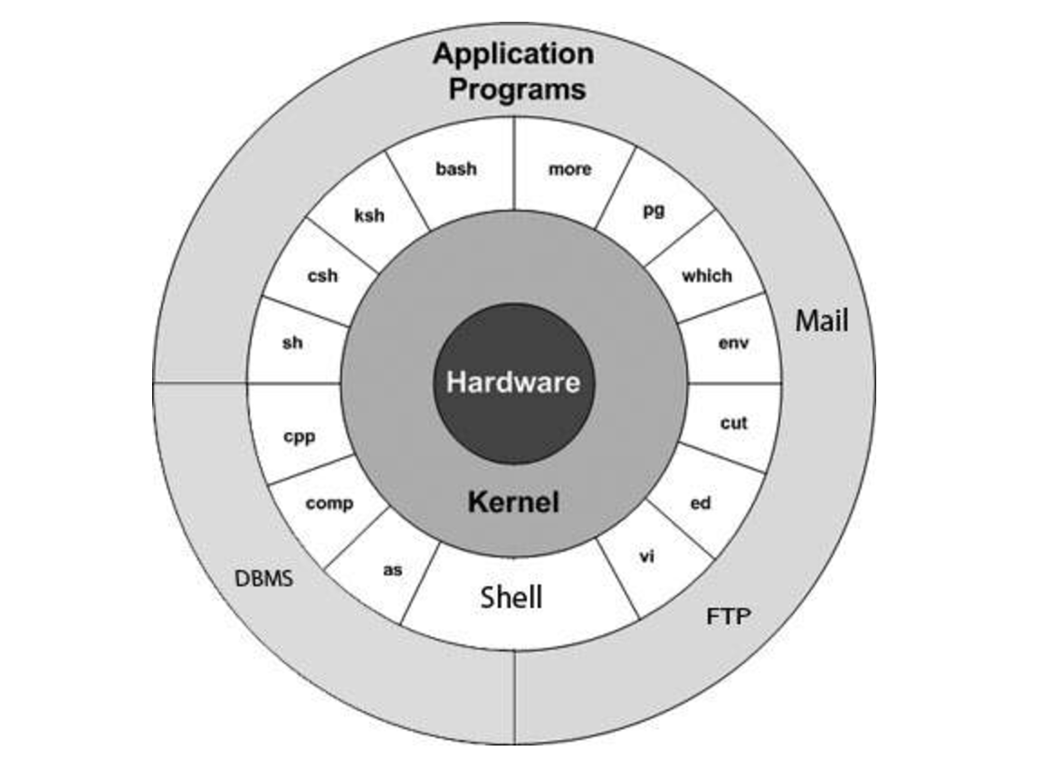
Unix OS architecture
System programs
and
System libraries
(one layer)
Kernel
(another layer)
From https://www.tutorialspoint.com

Slide 38
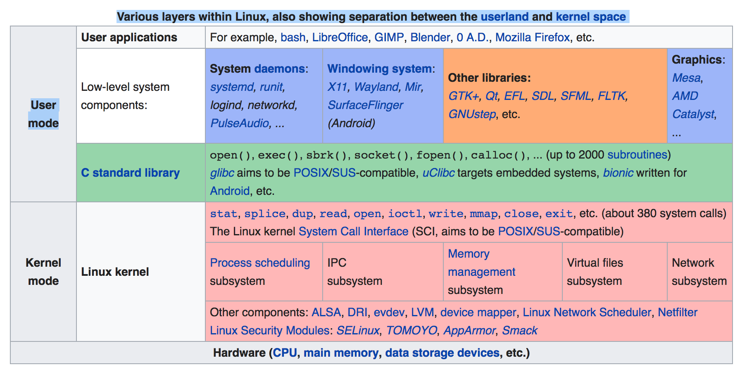
Linux OS architecture
from wikipedia

Slide 39
Microkernel System Structure
Moves as much from the kernel into “user” space
Communication takes place between user modules using message passing
Benefits:
Easier to extend a microkernel
Easier to port the operating system to new architectures
More reliable (less code is running in kernel mode)
More secure
Detriments:
Performance overhead of user space to kernel space communication

Slide 40
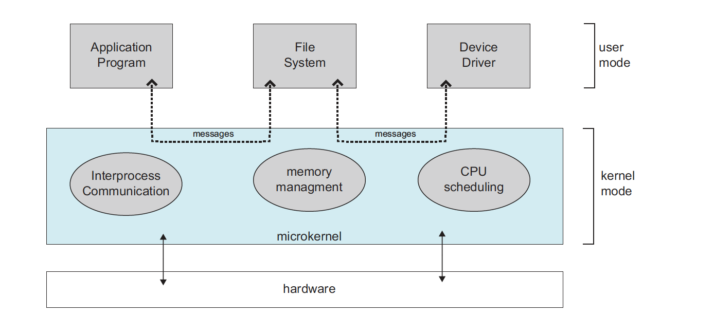
Microkernels
OS
Architecture of a typical microkernel OS

Slide 41
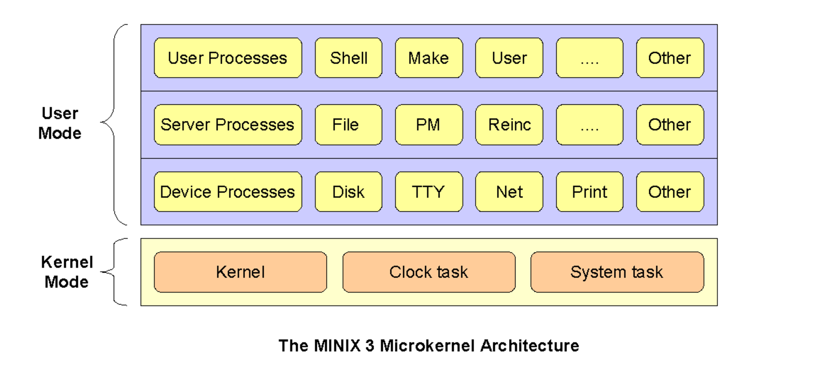
MINIX3 OS architecture
from wikipedia

Slide 42
Modules
Most modern operating systems implement kernel modules
Uses object-oriented approach
Each core component is separate
Each talks to the others over known interfaces
Each is loadable as needed within the kernel
Overall, similar to layers but more flexible
Linux supports modules
User mode
App
App
Monolithic kernel
module
module
Kernel mode
module
module
module
module

Slide 43
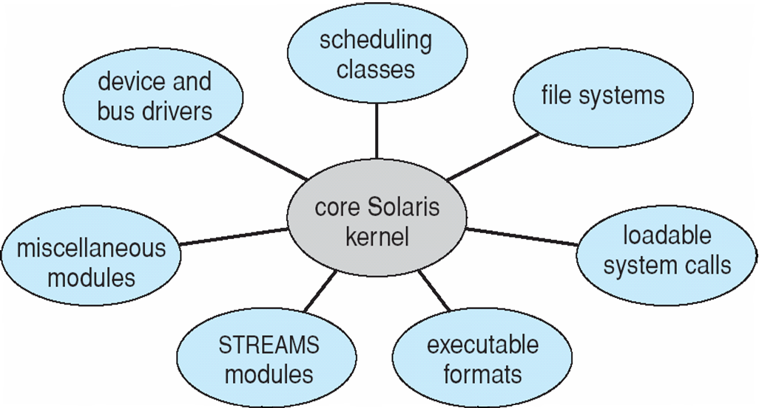
Solaris Modular Approach

Slide 44
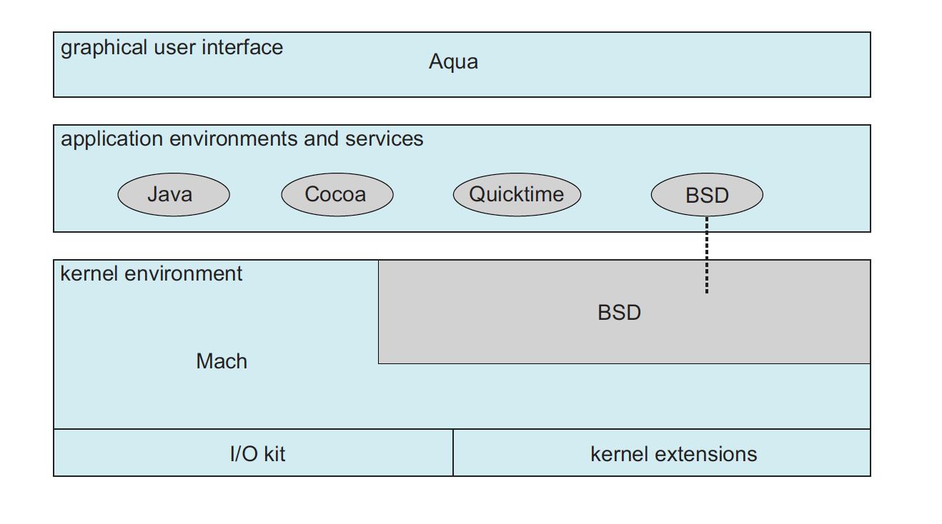
Hybrid Systems
Mac OS X
Uses Mach and BSD kernels
Mach: microkernel
BSD: monolithic

Slide 45
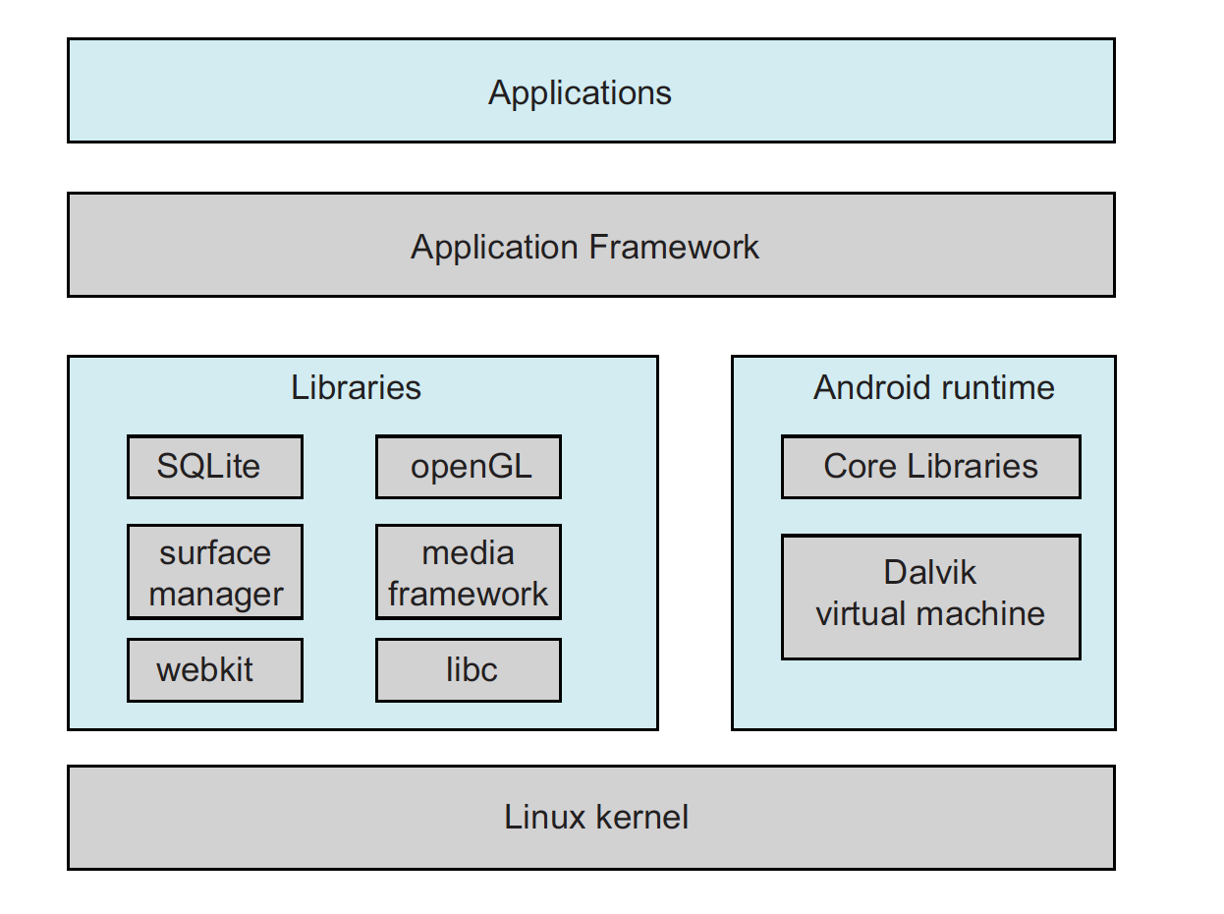
Hybrid Systems
Android
Uses Linux kernel
Layered stack of software on Linux kernel
A rich set of frameworks to develop and run Android applications

Slide 46
Virtualization
Virtualization abstracts/virtualize the hardware so that OSs and programs can run on a virtualized machine or environment
Many different types of virtualizations:
Virtual machines: run OS/Apps on a VM that is identical to the bare hardware
For example: run Linux OS compiled for Intel x86 on a virtual machine duplicating x86 hardware.
Emulation: run OS or App developed for a machine that is different than the bare hardware
For example: run app developed for MIPS on Intel x86 using an emulator (MIPS emulation on x86).
Abstract machines: run applications developed/compiled for an abstract machine running on bare hardware (interpretation)
For example JVM. Run a Java app on JVM running on x86

Slide 47
Virtual Machines
Hardware is abstracted into several different execution environments
Virtual machines
Each virtual machine provides an interface that is identical to the bare hardware
A guest process/kernel can run on top of a virtual machine.
We can run several operating systems on the same host.
Each virtual machine will run another operating system (guest).

Slide 48
Virtual Machines
processes
processes
processes
processes
Guest OS
Guest OS
Guest OS
VM1
VM2
VM3
Virtual Machine Implementation (VMM)
Host Operating System
Hardware
VMM is a hosted virtual machine (running on a host OS) – Type-2 Hypervisor
Example: WMware Workstation

Slide 49
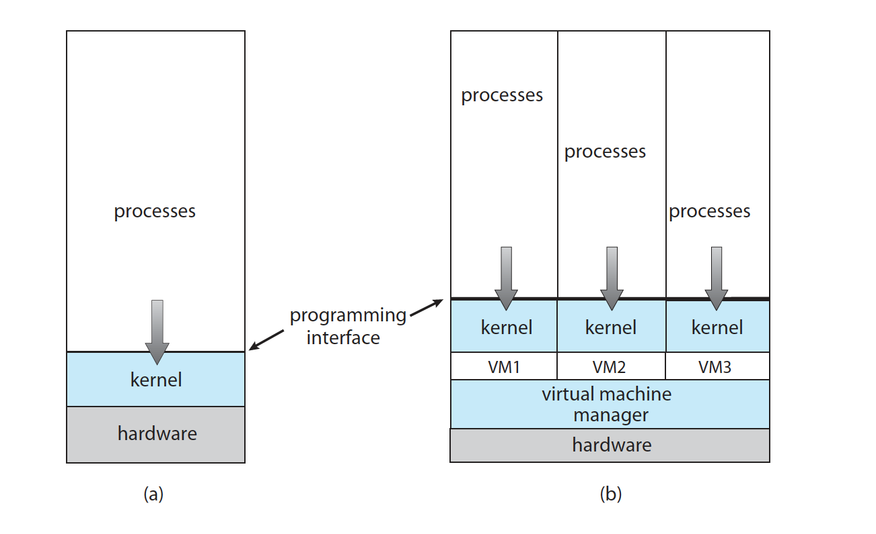
Virtual Machines
VMM is running directly on hardware like an OS: Type-1 Hypervisor
Example: Wmware ESX Hypervisor

Slide 50
Virtualization
Vmware (Virtual Machine Manager– VMM)
Abstracts Intel x86 hardware
Java virtual machine (JVM)
Specification of an abstract computer
.NET Framework
Specification of an abstract computer again

Slide 51
Operating System Debugging
Failure analysis
Log files
Core dump
Crash dump
Performance tuning
Monitor system performance
Add code to kernel
Use system tools like “top”
DTrace
Facility for dynamically adding probes to a running system (both to processes and to the kernel)
Probes can be queried using D programming language to obtain info

Slide 52
Operating System Generation
Configure the kernel
Compile the kernel

Slide 53
System Boot
Bootstrap program (loader) locates the kernel, loads it and starts the kernel.
This can be a two-step procedure.
Bootstrap program loads another more complex boot program
That boot program loads the kernel
Then control is given to kernel.
Kernel starts the environment and makes the computer ready to interact with the user (via a GUI or command shell).
Details depend on the system

Slide 54
References
Operating System Concepts, 9th edition, Silberschatz et al. Wiley.
Modern Operating Systems, Andrew S. Tanenbaum, 3rd edition, 2009.
These slides are adapted/modified from the textbook and its slides: Operating System Concepts, Silberschatz et al., 7th & 8th editions, Wiley.
Computer Systems, A Programmer’s Perspective, 3rd edition, R. E> Bryant and D. R. O’Hallaron, Pearson, 2016.

